Slide 1
Time Series Data

Slide 2
What is Time Series Data?
A sequence of data points collected or recorded at specific time intervals.
Examples:
Stock prices (daily)
Temperature (hourly)
Sales data (monthly)

Slide 3
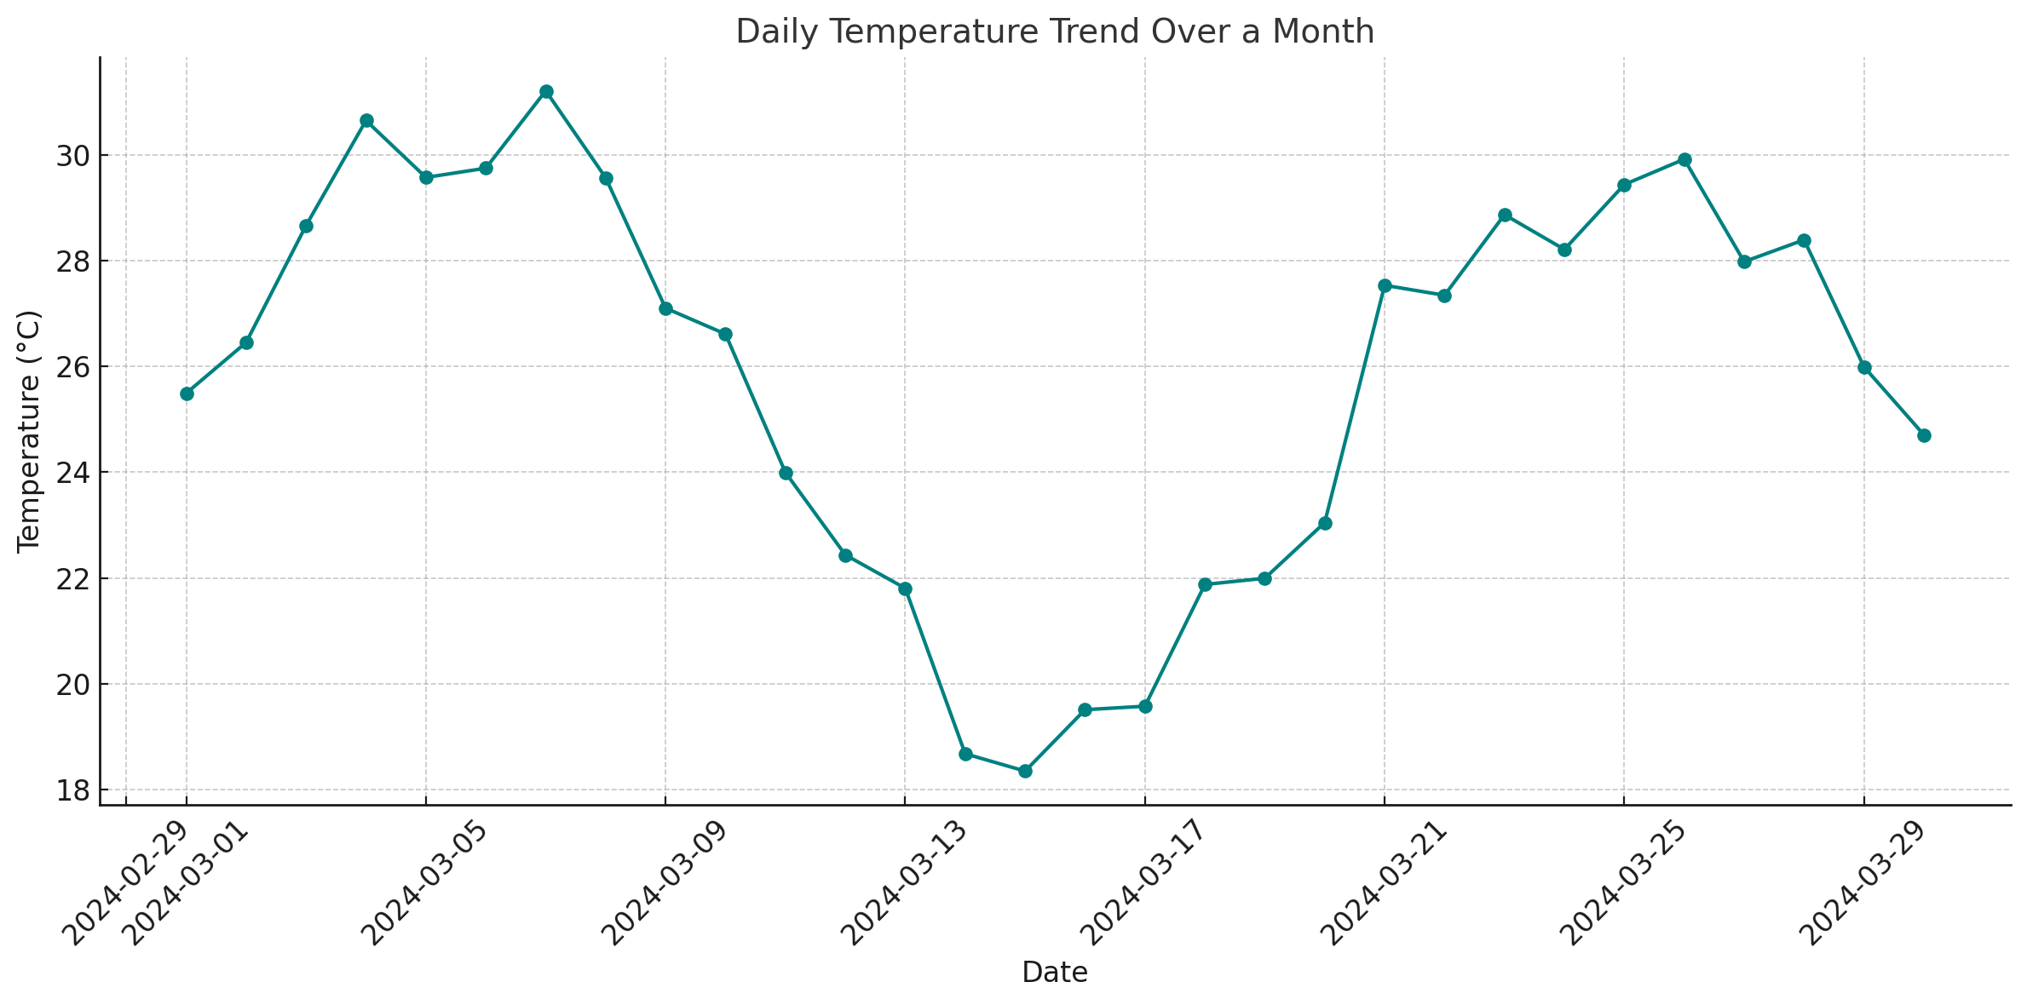

Slide 4
Components of Time Series
Trend: Long-term movement
Seasonality: Regular pattern based on time (e.g., sales increase during holidays)
Cyclic Patterns: Long-term fluctuations without fixed period
Irregular/Noise: Random variation

Slide 5
A great real-life example of cyclic patterns in time series data—where long-term fluctuations occur without a fixed or predictable frequency—can be seen in economic and financial data.
The unemployment rate in a country (like the USA or India) fluctuates over decades. These changes:
Are influenced by economic cycles (like recessions and booms),
Don't follow a fixed seasonal schedule,
Can last multiple years in a rising or falling trend,
Are often tied to macroeconomic events, not short-term patterns.

Slide 6
Feature | Description
Duration | Varies (can be 2–10 years)
Cause | Business cycles, policy changes, global crises
Example Events | 2008 Global Recession, COVID-19 Pandemic
Predictability | Hard to predict exact timing/frequency

Slide 7
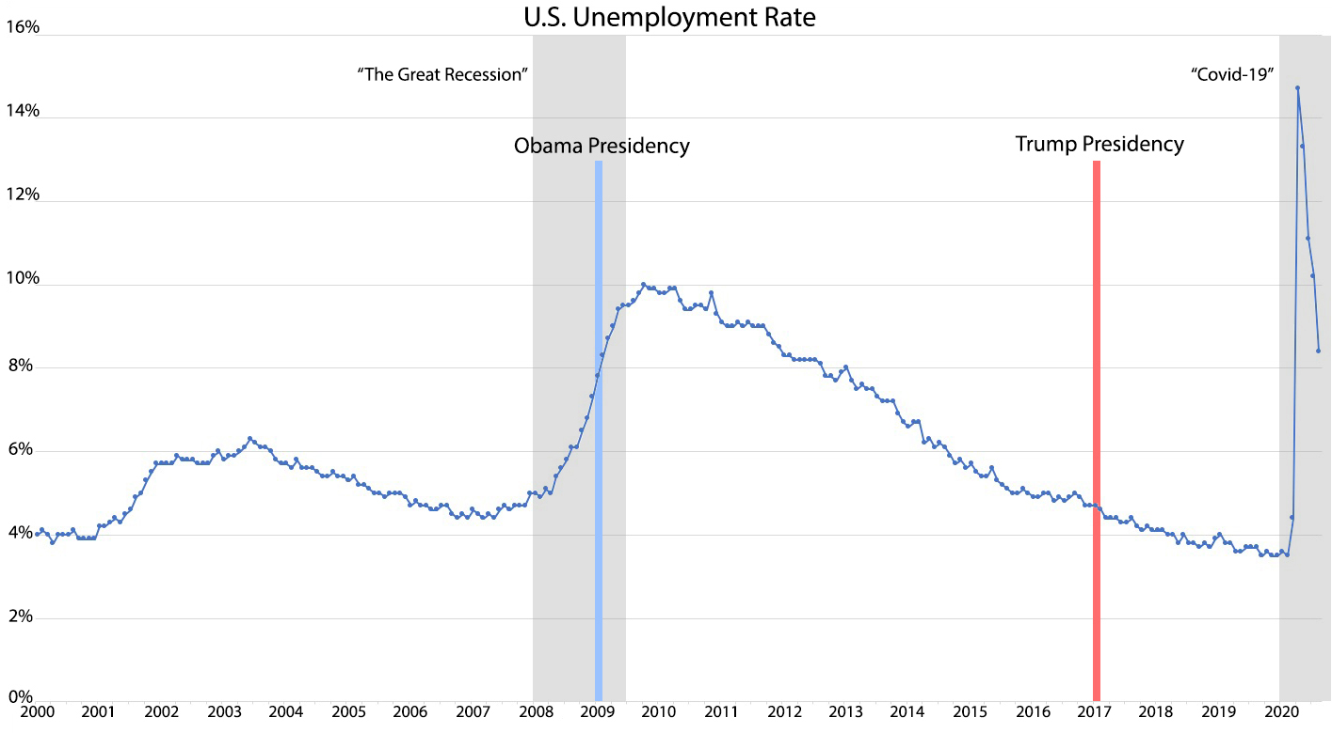

Slide 8
2008 Recession: A significant increase in unemployment rates during the global financial crisis.​
Post-Recession Recovery: A gradual decline in unemployment rates as the economy recovered.
​2020 COVID-19 Pandemic: A sharp spike in unemployment due to widespread economic disruptions.

Slide 9
Trends in Time Series
Definition: Consistent upward or downward movement in data
Detection: Moving averages, regression lines

Slide 10
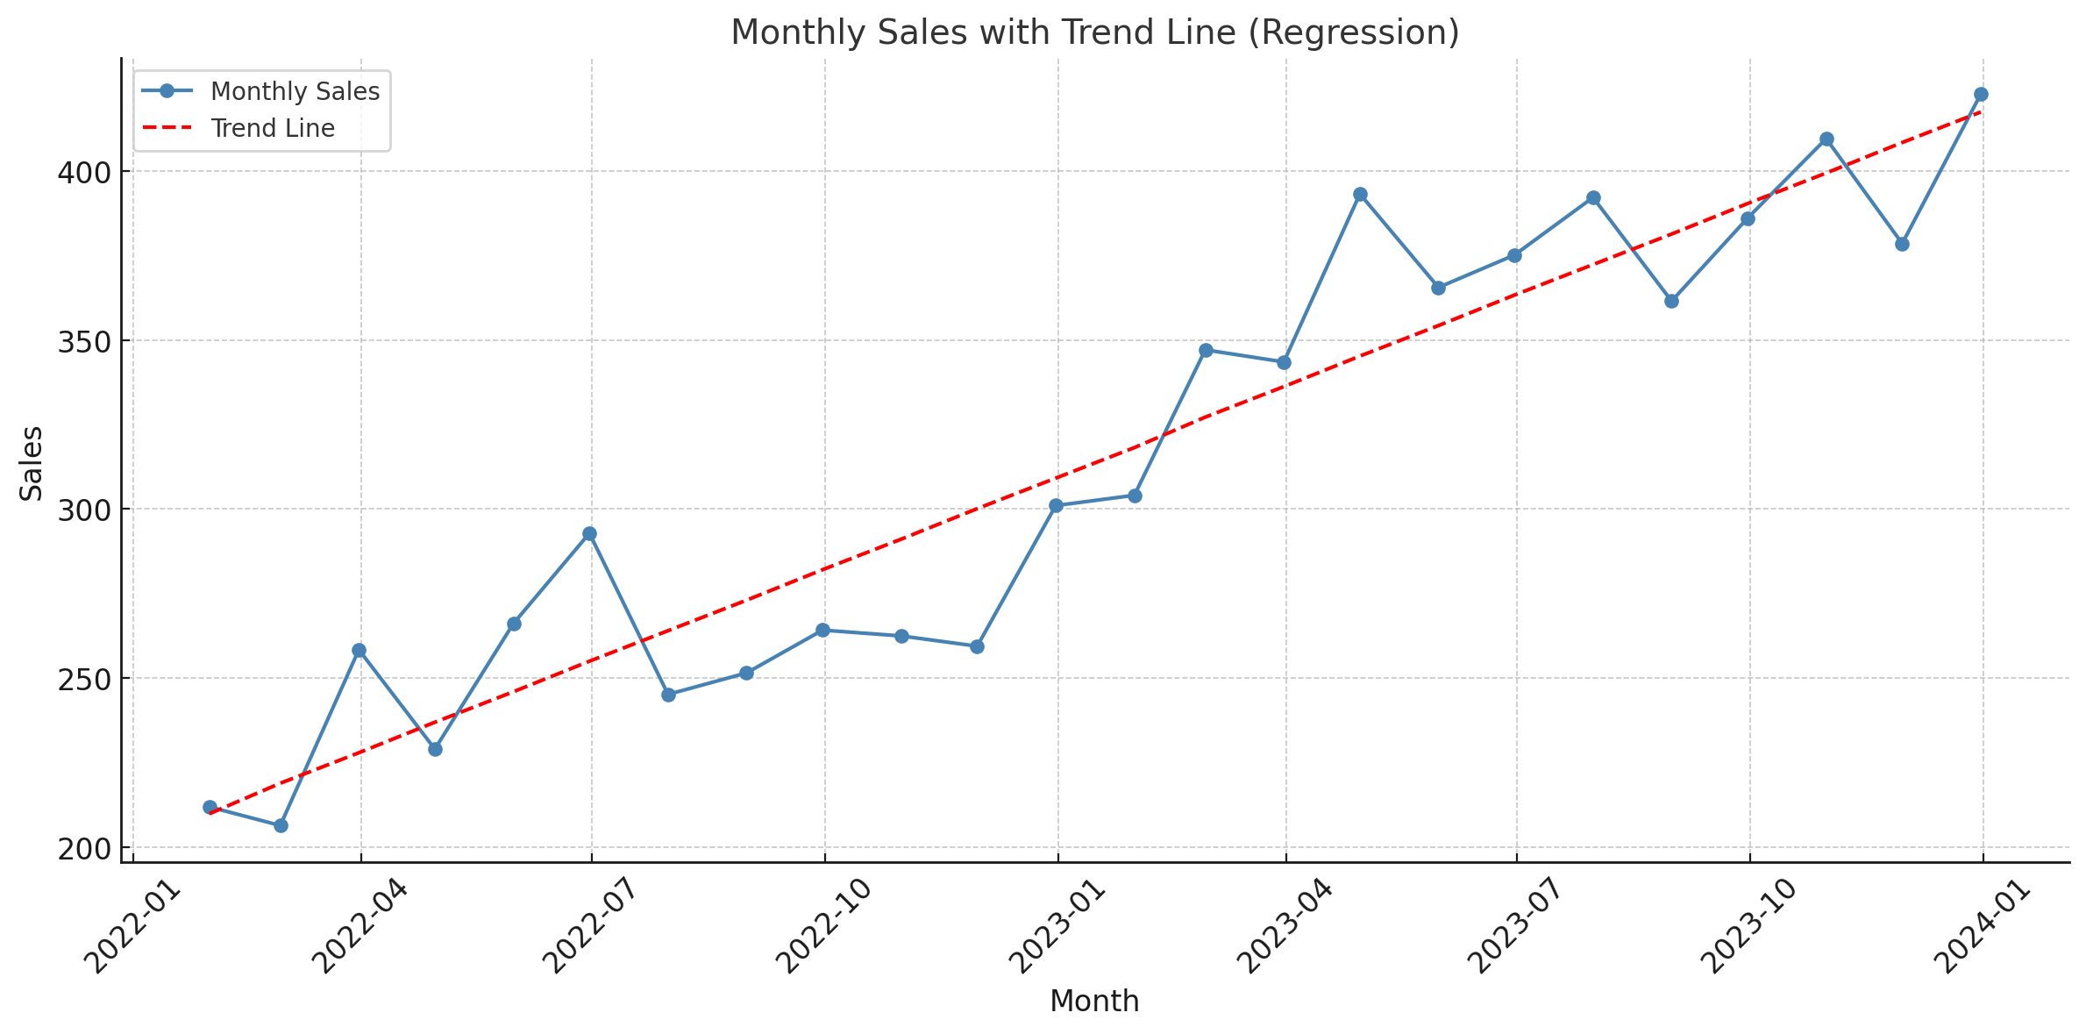

Slide 11
Autoregressive Model (AR)
An Autoregressive (AR) model is a type of time series model where the current value of a variable is predicted using a linear combination of its own past values.
In simple terms:“Today’s value depends on previous values.”

Slide 12
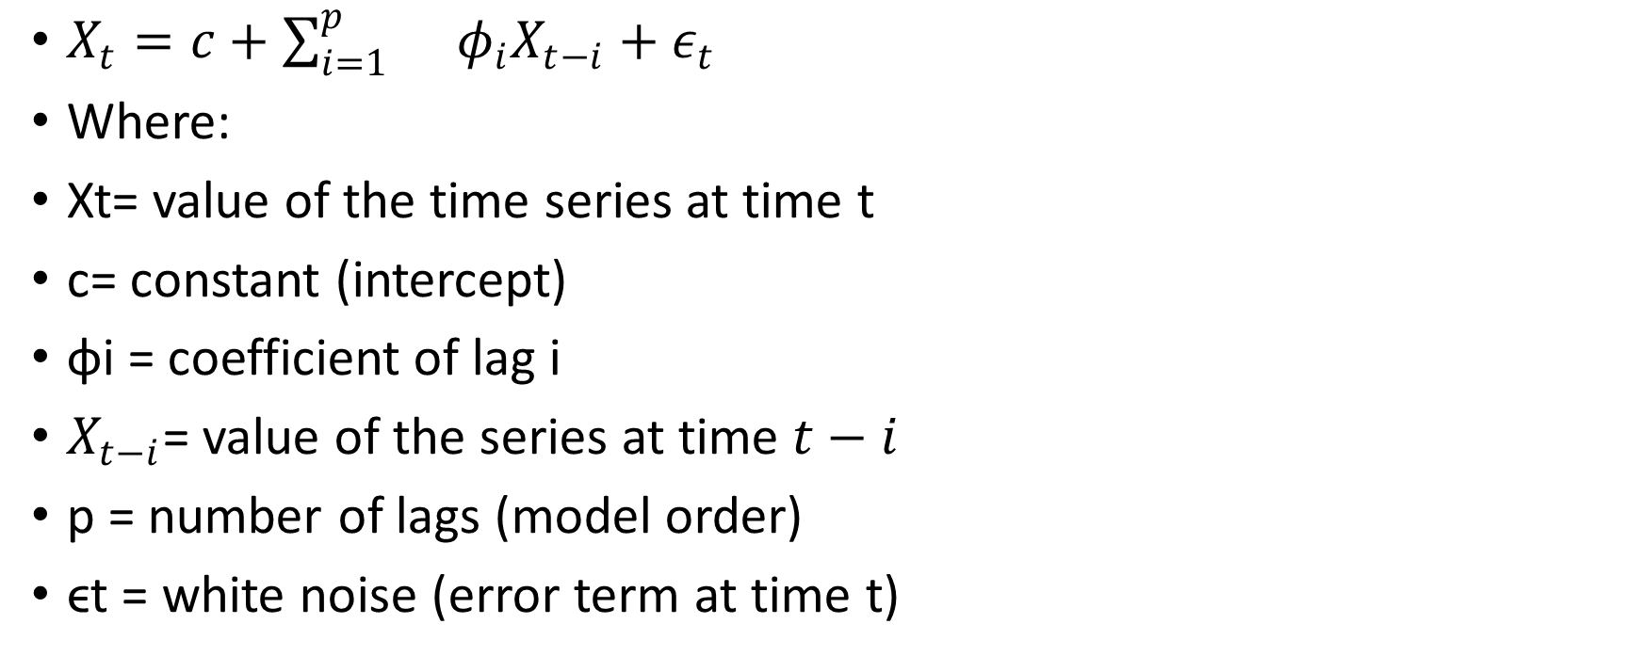
$X_{t}=c+\sum_{i=1}^{p}{}φ_{i}X_{t−i}+ε_{t}$
Where:
Xt= value of the time series at time t
c= constant (intercept)
ϕi = coefficient of lag i
$X_{t−i}$= value of the series at time $t−i$
p = number of lags (model order)
ϵt​ = white noise (error term at time t)

Slide 13
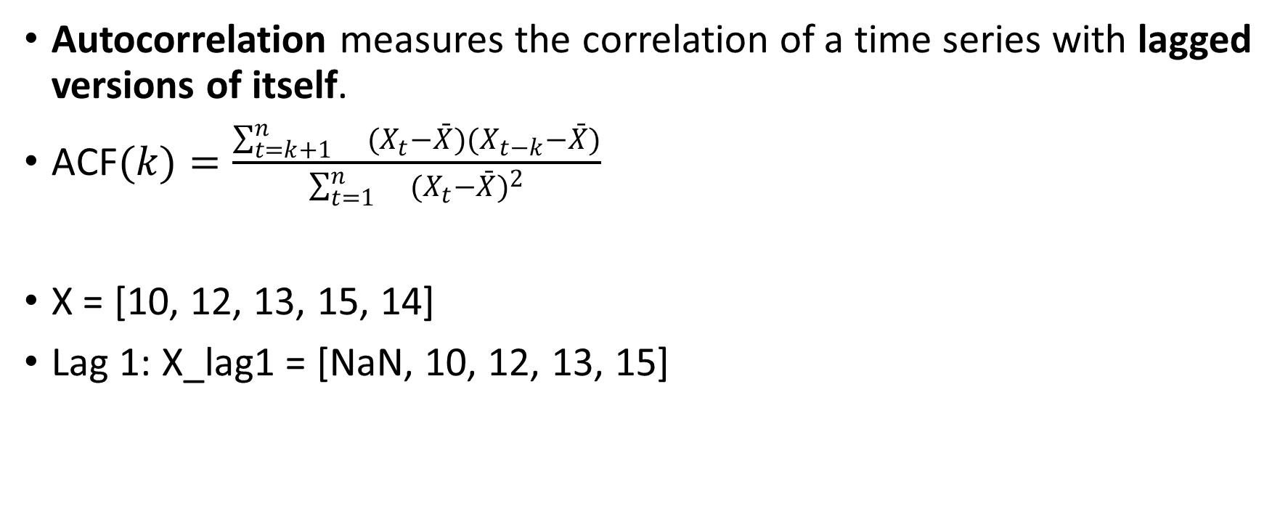
Autocorrelation Function (ACF)
Autocorrelation measures the correlation of a time series with lagged versions of itself.
$\text{ACF}(k)=\frac{\sum_{t=k+1}^{n}{}(X_{t}−\overset{ˉ}{X})(X_{t−k}−\overset{ˉ}{X})}{\sum_{t=1}^{n}{}(X_{t}−\overset{ˉ}{X})^{2}}$
X = [10, 12, 13, 15, 14]
Lag 1: X_lag1 = [NaN, 10, 12, 13, 15]

Slide 14
Time (t) | Value (Xₜ)
1 | 10
2 | 12
3 | 13
4 | 15
5 | 14

Slide 15

Calculate ACF at Lag 1
Calculate the mean of the series
$\text{X}\text{ = [10, 12, 13, 15, 14]}\overset{ˉ}{X}=\frac{10+12+13+15+14}{5}=\frac{64}{5}=12.8$

Slide 16
We drop the first row since there's no previous value for time 1.
Xₜ | Xₜ₋₁
12 | 10
13 | 12
15 | 13
14 | 15

Slide 17
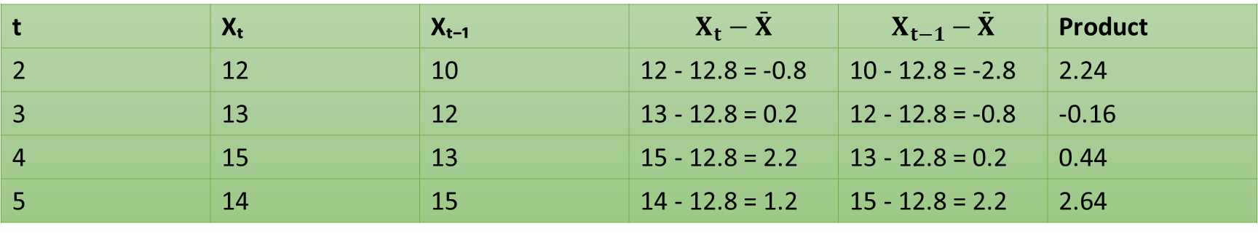

Calculate numerator of ACF(1)
$\sum_{t=2}^{5}{}(X_{t}−\overset{ˉ}{X})(X_{t−1}−\overset{ˉ}{X})$
Sum of products (numerator) = $2.24−0.16+0.44+2.64=5.16$
t | Xₜ | Xₜ₋₁ | $$X_{t}−\overset{ˉ}{X}$$ | $$X_{t−1}−\overset{ˉ}{X}$$ | Product
2 | 12 | 10 | 12 - 12.8 = -0.8 | 10 - 12.8 = -2.8 | 2.24
3 | 13 | 12 | 13 - 12.8 = 0.2 | 12 - 12.8 = -0.8 | -0.16
4 | 15 | 13 | 15 - 12.8 = 2.2 | 13 - 12.8 = 0.2 | 0.44
5 | 14 | 15 | 14 - 12.8 = 1.2 | 15 - 12.8 = 2.2 | 2.64

Slide 18
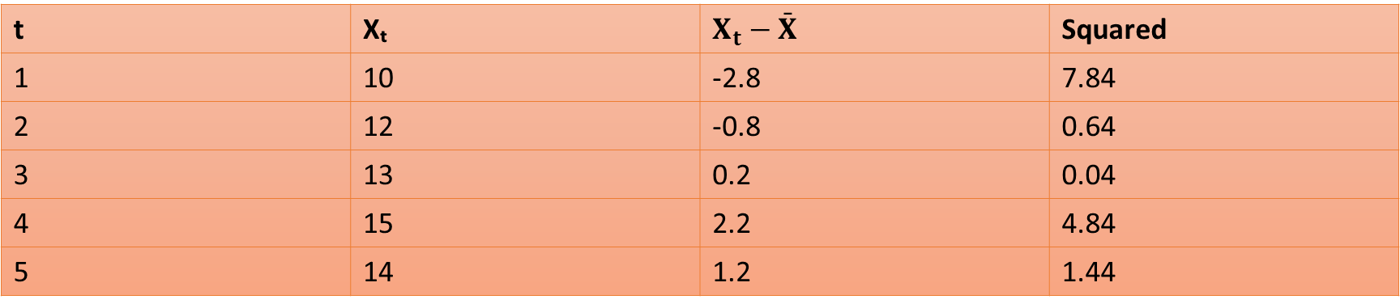

Calculate denominator
$\sum_{t=1}^{5}{}(X_{t}−\overset{ˉ}{X})^{2}$
t | Xₜ | $$X_{t}−\overset{ˉ}{X}$$ | Squared
1 | 10 | -2.8 | 7.84
2 | 12 | -0.8 | 0.64
3 | 13 | 0.2 | 0.04
4 | 15 | 2.2 | 4.84
5 | 14 | 1.2 | 1.44

Slide 19
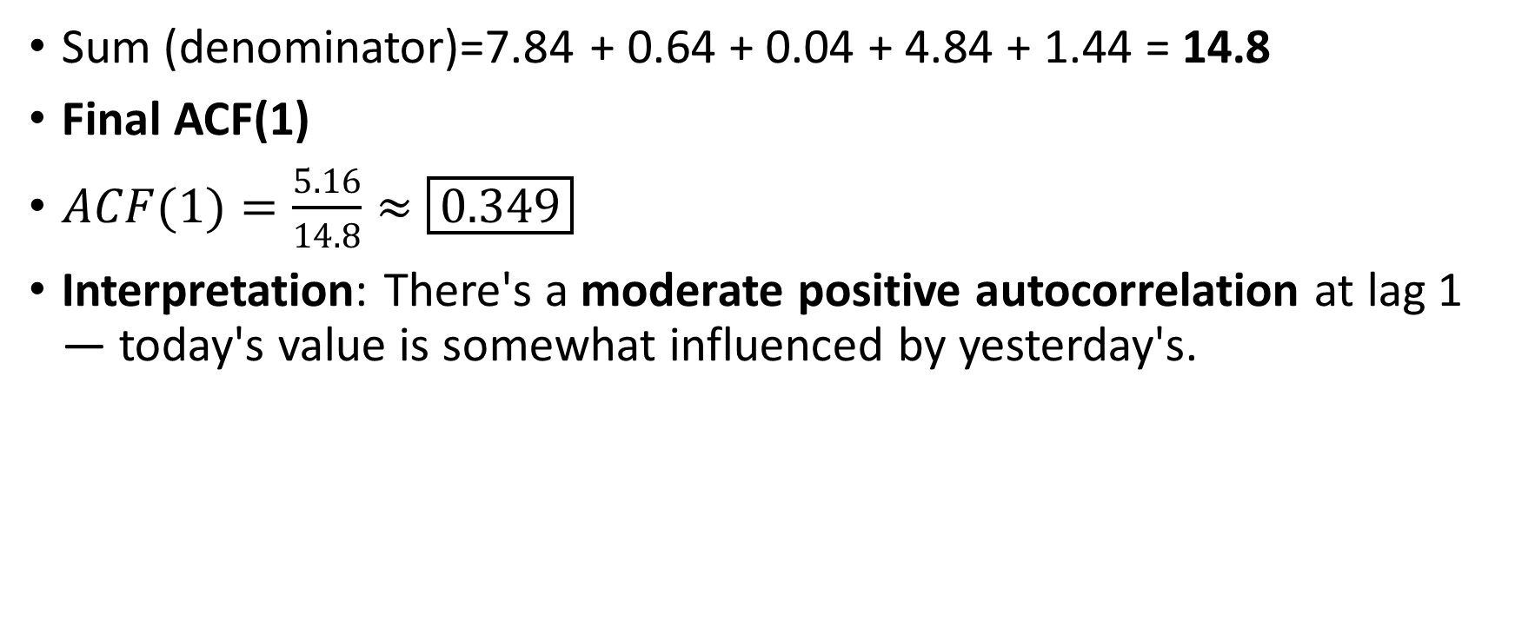
Sum (denominator)=7.84 + 0.64 + 0.04 + 4.84 + 1.44 = 14.8
Final ACF(1)
$ACF(1)=\frac{5.16}{14.8}≈\boxed{0.349}$
Interpretation: There's a moderate positive autocorrelation at lag 1 — today's value is somewhat influenced by yesterday's.

Slide 20
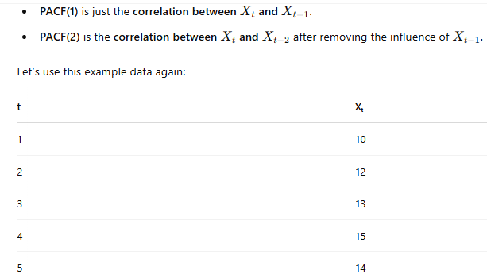

Partial Autocorrelation Function (PACF)
PACF measures the pure correlation between Xt​ and $X_{t−k}$, removing the influence of intermediate lags (like lag 1 to lag k−1).

Slide 21
PACF(1)
PACF(1) = ACF(1) ≈ 0.349
Calculate PACF(2)
Regress Xt on Xt−1
Regress Xt−2 on Xt−1

Slide 22
Build lag columns
We start at time t=3 (since we need both lag 1 and lag 2).
Let’s label:
Y = Xₜ
X1 = Xₜ₋₁
X2 = Xₜ₋₂
t | Xₜ | Xₜ₋₁ | Xₜ₋₂
3 | 13 | 12 | 10
4 | 15 | 13 | 12
5 | 14 | 15 | 13

Slide 23
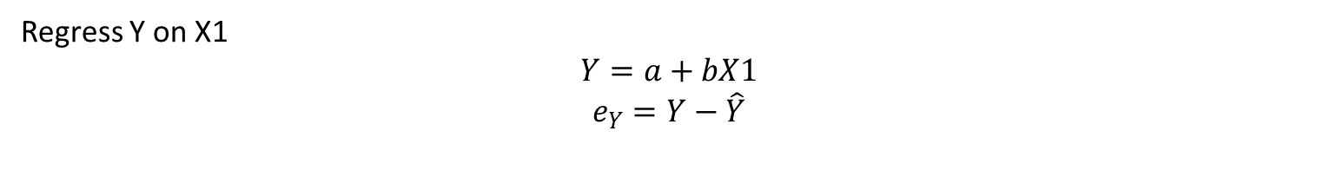
Y | X1 | X2
13 | 12 | 10
15 | 13 | 12
14 | 15 | 13
Regress Y on X1
$$Y=a+bX1$$
$$e_{Y}=Y−\hat{Y}$$

Slide 24
X1 | Y | Ŷ = 3.36 + 0.69·X1 | Residual eY
12 | 13 | 11.64 | 1.36
13 | 15 | 12.33 | 2.67
15 | 14 | 13.71 | 0.29
Regress X2 on X1
X1 | X2 | Ŷ = 4.23 + 0.58·X1 | Residual eX2e_{X2}eX2​
12 | 10 | 11.19 | -1.19
13 | 12 | 11.77 | 0.23
15 | 13 | 12.93 | 0.07

Slide 25

Find Correlation
e_Y | e_X2
1.36 | -1.19
2.67 | 0.23
0.29 | 0.07
$$\text{PACF}(2)≈−0.69$$

Slide 26
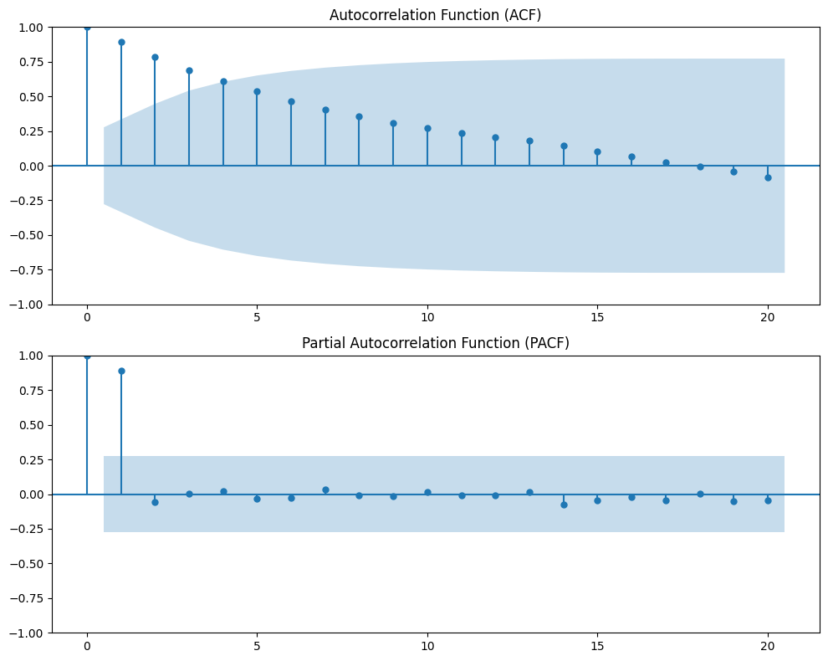

Slide 27
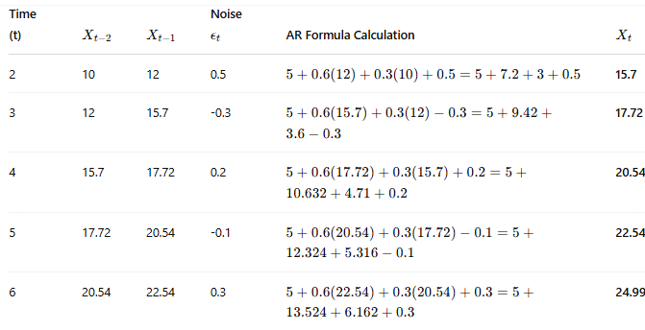

Slide 28
Moving Average (MA)
A Moving Average is a statistical technique used to smooth out short-term fluctuations and highlight longer-term trends in time series data by averaging data points over a specific period.

Slide 29
Smoothing Noise: Filters out random fluctuations or "noise" in the data.
Trend Detection: Helps identify underlying trends over time.
Forecasting: Used in models like ARIMA (AutoRegressive Integrated Moving Average) to forecast future values.

Slide 30
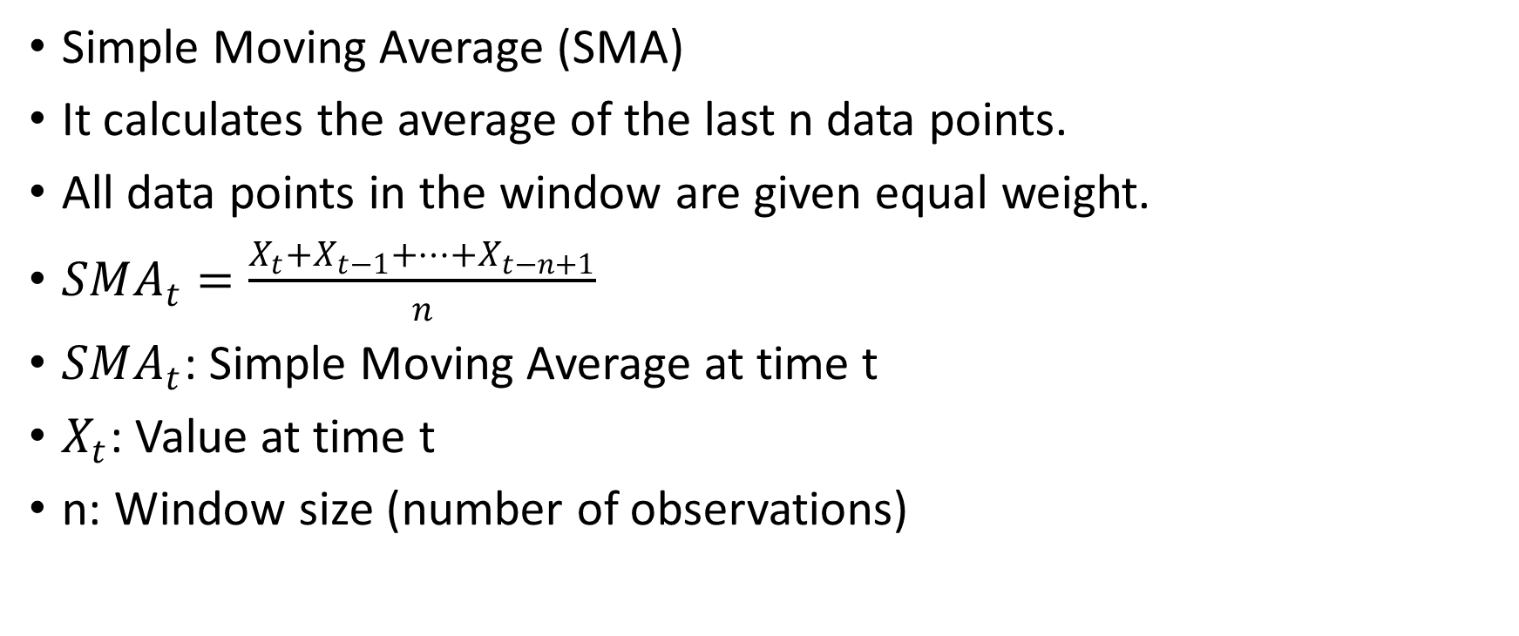
Types of Moving Averages
Simple Moving Average (SMA)
It calculates the average of the last n data points.
All data points in the window are given equal weight.
$SMA_{t}=\frac{X_{t}+X_{t−1}+⋯+X_{t−n+1}}{n}$
$SMA_{t}$​: Simple Moving Average at time t
$X_{t}$​: Value at time t
n: Window size (number of observations)

Slide 31
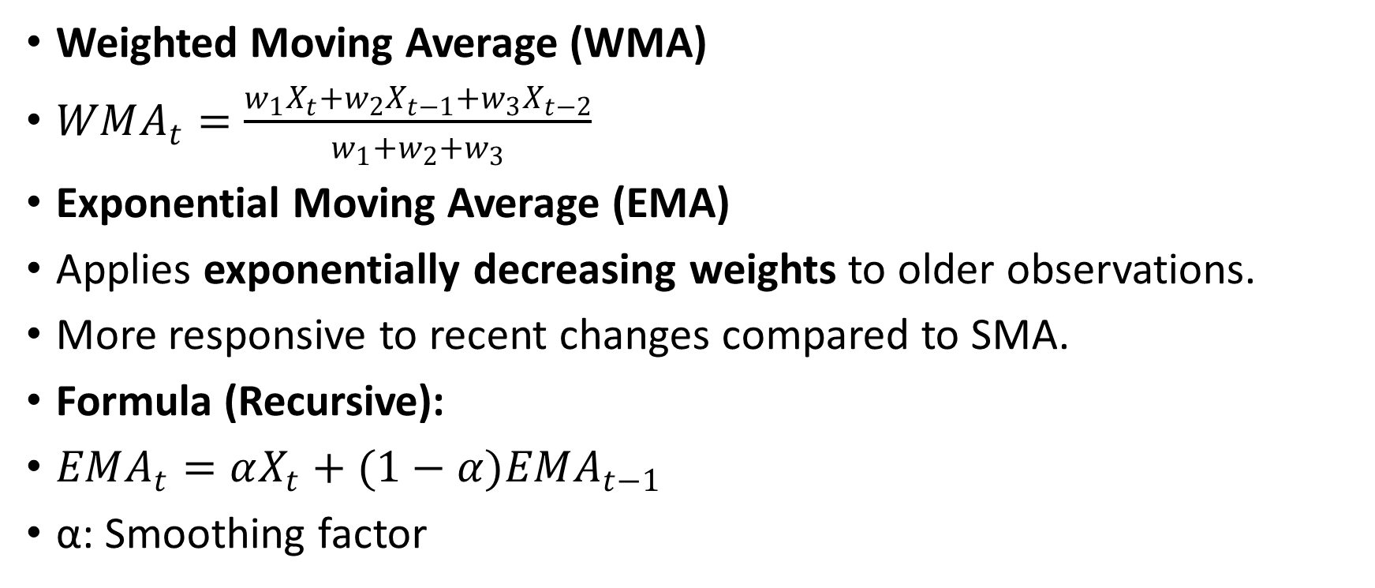
Weighted Moving Average (WMA)
$WMA_{t}=\frac{w_{1}X_{t}+w_{2}X_{t−1}+w_{3}X_{t−2}}{w_{1}+w_{2}+w_{3}}$
Exponential Moving Average (EMA)
Applies exponentially decreasing weights to older observations.
More responsive to recent changes compared to SMA.
Formula (Recursive):
$EMA_{t}=αX_{t}+(1−α)EMA_{t−1}$
α: Smoothing factor

Slide 32
Day | Visits
1 | 100
2 | 120
3 | 130
4 | 90
5 | 110
6 | 150
7 | 170
3-Day Simple Moving Average:
For Day 3: (100 + 120 + 130) / 3 = 116.67
For Day 4: (120 + 130 + 90) / 3 = 113.33
For Day 5: (130 + 90 + 110) / 3 = 110

Slide 33
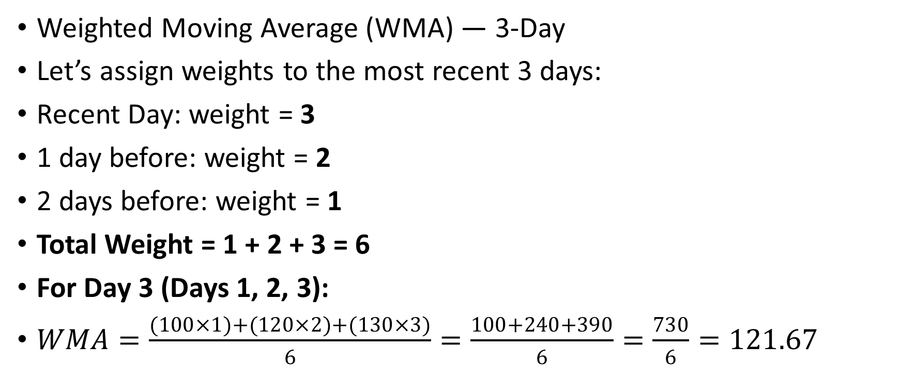
Weighted Moving Average (WMA) — 3-Day
Let’s assign weights to the most recent 3 days:
Recent Day: weight = 3
1 day before: weight = 2
2 days before: weight = 1
Total Weight = 1 + 2 + 3 = 6
For Day 3 (Days 1, 2, 3):
$WMA=\frac{(100×1)+(120×2)+(130×3)}{6}=\frac{100+240+390}{6}=\frac{730}{6}=121.67$

Slide 34
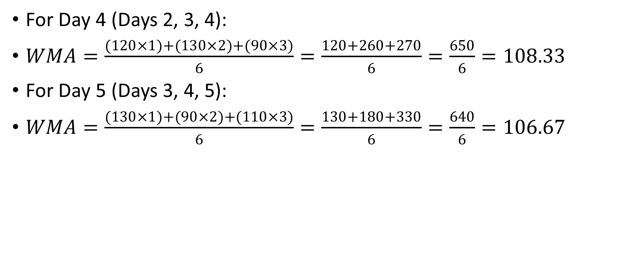
For Day 4 (Days 2, 3, 4):
$WMA=\frac{(120×1)+(130×2)+(90×3)}{6}=\frac{120+260+270}{6}=\frac{650}{6}=108.33$
For Day 5 (Days 3, 4, 5):
$WMA=\frac{(130×1)+(90×2)+(110×3)}{6}=\frac{130+180+330}{6}=\frac{640}{6}=106.67$

Slide 35
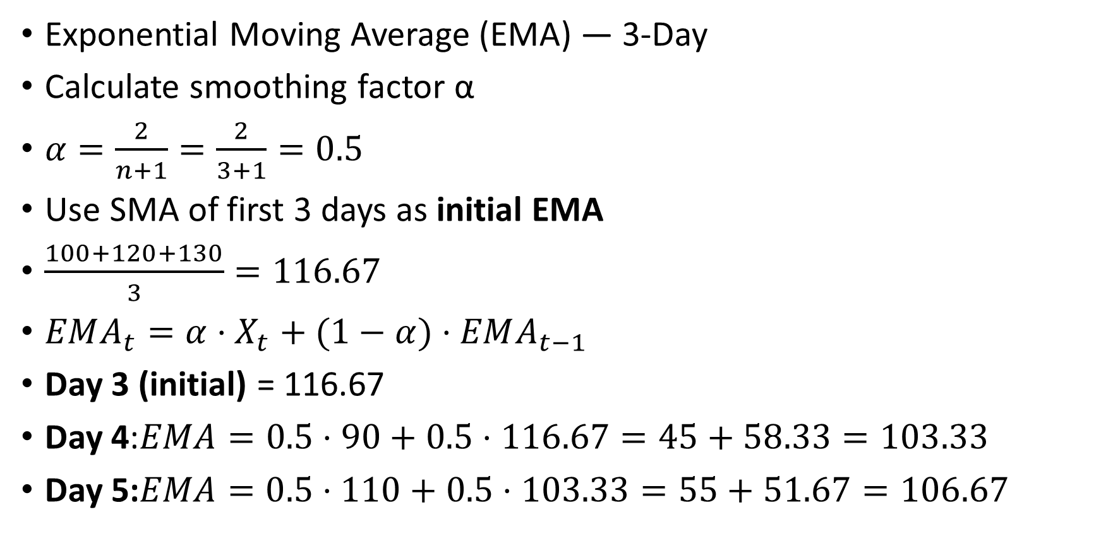
Exponential Moving Average (EMA) — 3-Day
Calculate smoothing factor α
$α=\frac{2}{n+1}=\frac{2}{3+1}=0.5$
Use SMA of first 3 days as initial EMA
$\frac{100+120+130}{3}=116.67$
$EMA_{t}=α⋅X_{t}+(1−α)⋅EMA_{t−1}$
Day 3 (initial) = 116.67
Day 4:$EMA=0.5⋅90+0.5⋅116.67=45+58.33=103.33$
Day 5:$EMA=0.5⋅110+0.5⋅103.33=55+51.67=106.67$

Slide 36
Day | Visits | SMA (3-day) | WMA (3-day) | EMA (α=0.5)
1 | 100 | — | — | —
2 | 120 | — | — | —
3 | 130 | 116.67 | 121.67 | 116.67
4 | 90 | 113.33 | 108.33 | 103.33
5 | 110 | 110.00 | 106.67 | 106.67
6 | 150 | 116.67 | 126.67 | 128.33
7 | 170 | 143.33 | 153.33 | 149.17

